Slide 1

Converting Casual Cyclistic Riders to Annual Members
Dimitrios Karatzanos January 2023

Slide 2
Problem
Converting casual riders to annual members
Solution
Design a new marketing strategy

Slide 3
Analytical Goals
Determine how members and casual riders use Cyclistic bikes differently.
Make recommendations based on the analysis.

Slide 4
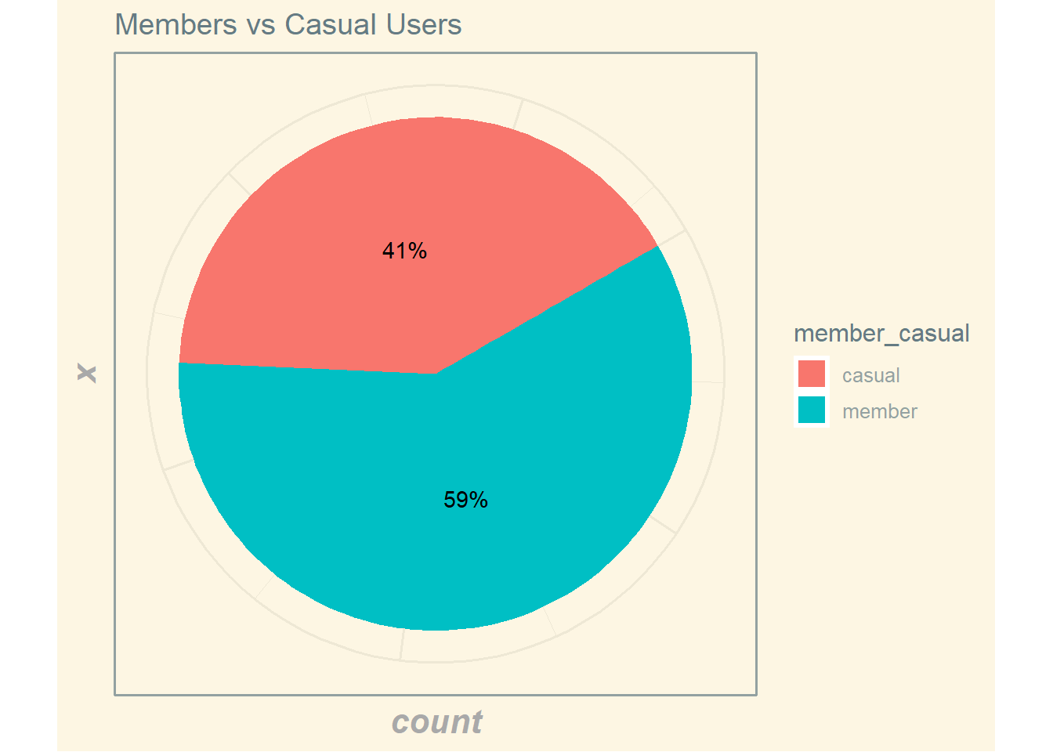
Members vs Casual
Casual riders make up 41% of our total bike riders.

Slide 5
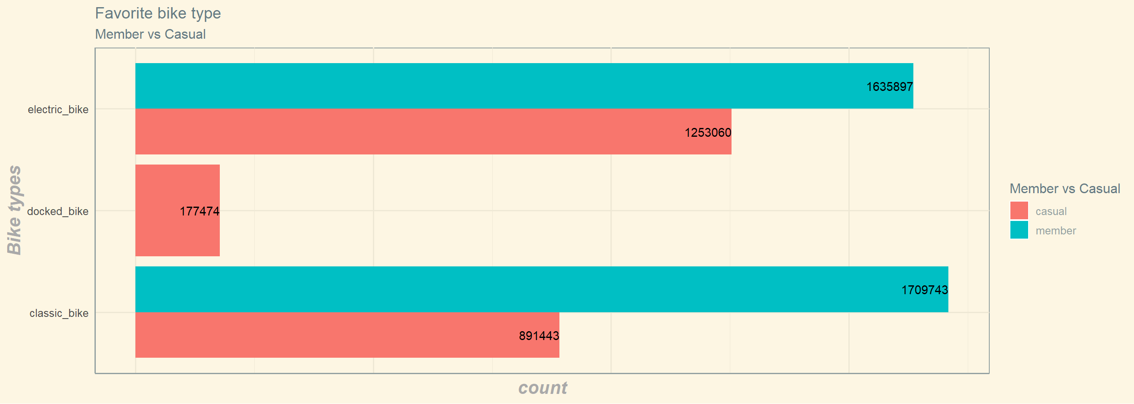
Favorite bike type
Classic bike is preferred by members
Electric bike is preferred by casual riders
Docked bike is used only by casual riders

Slide 6
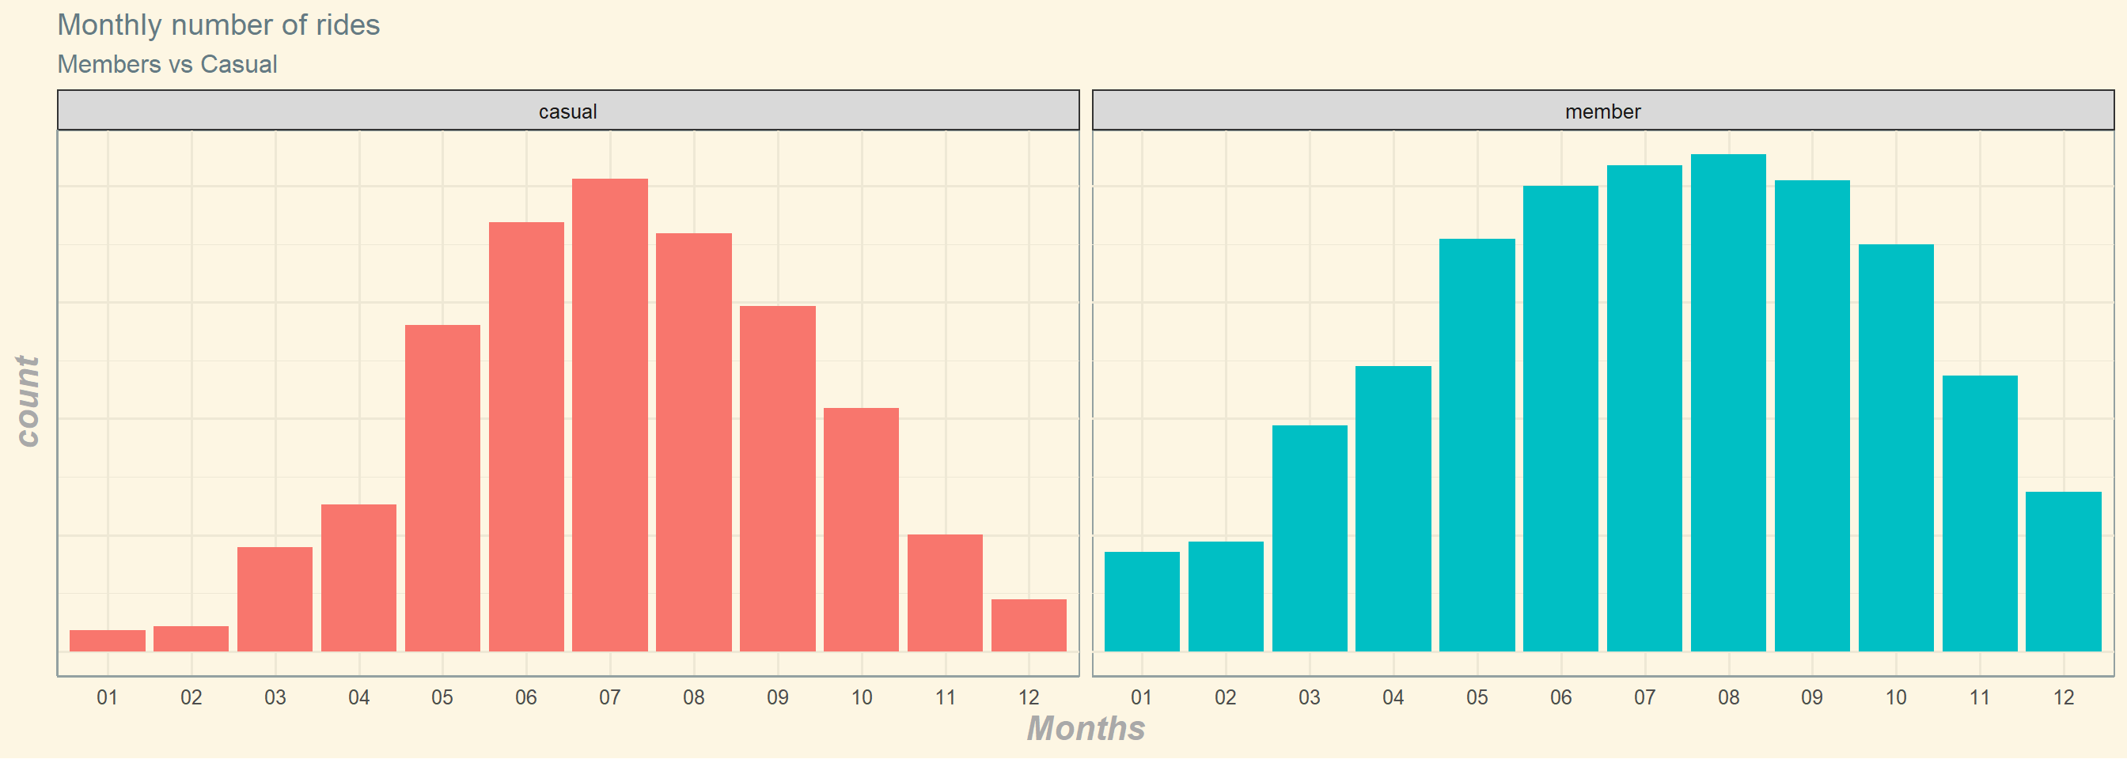
Monthly Distribution
Casual riders use our bikes mostly during summer.
Members use our bikes mostly from May to October.

Slide 7
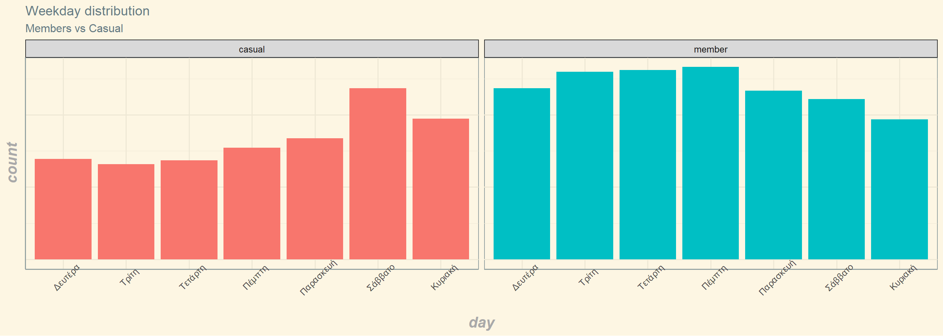
Weekday Distribution
Casual riders mostly use bikes during weekend
Members mostly use bikes during weekdays

Slide 8
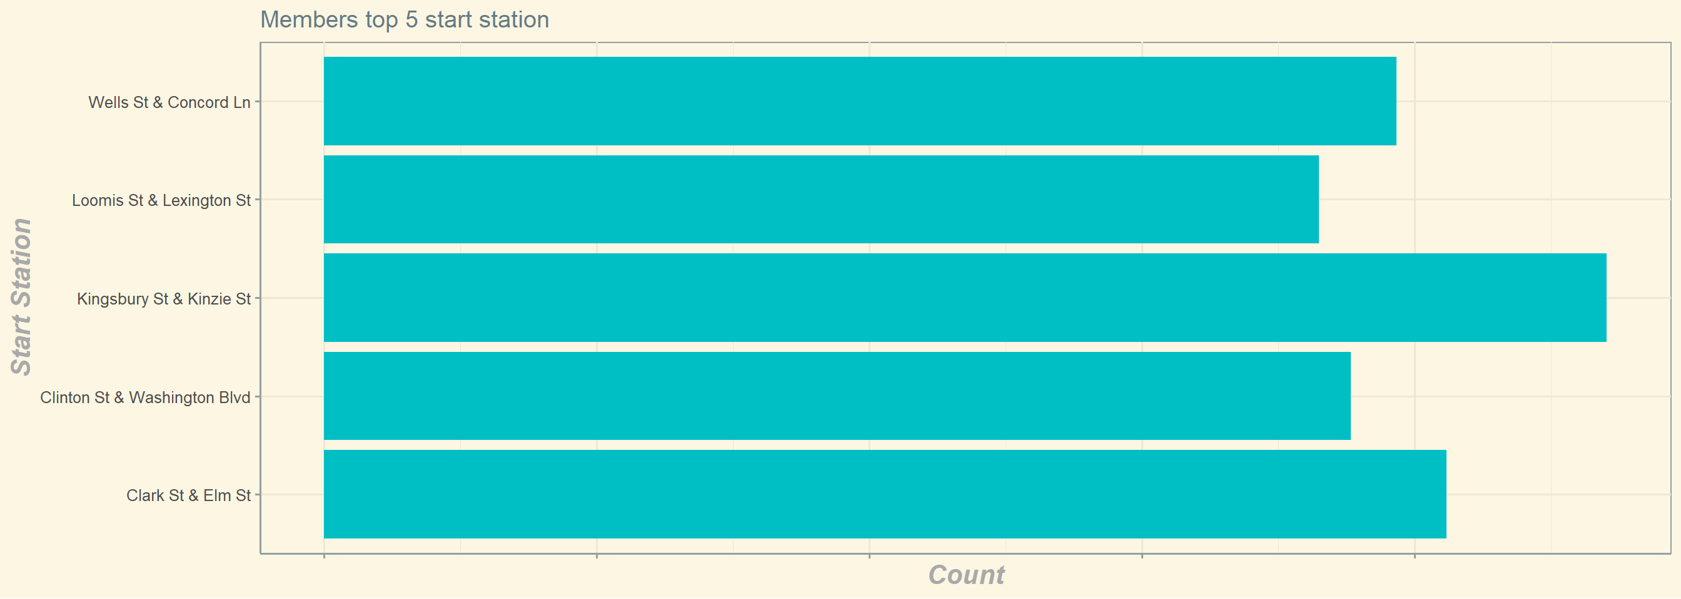
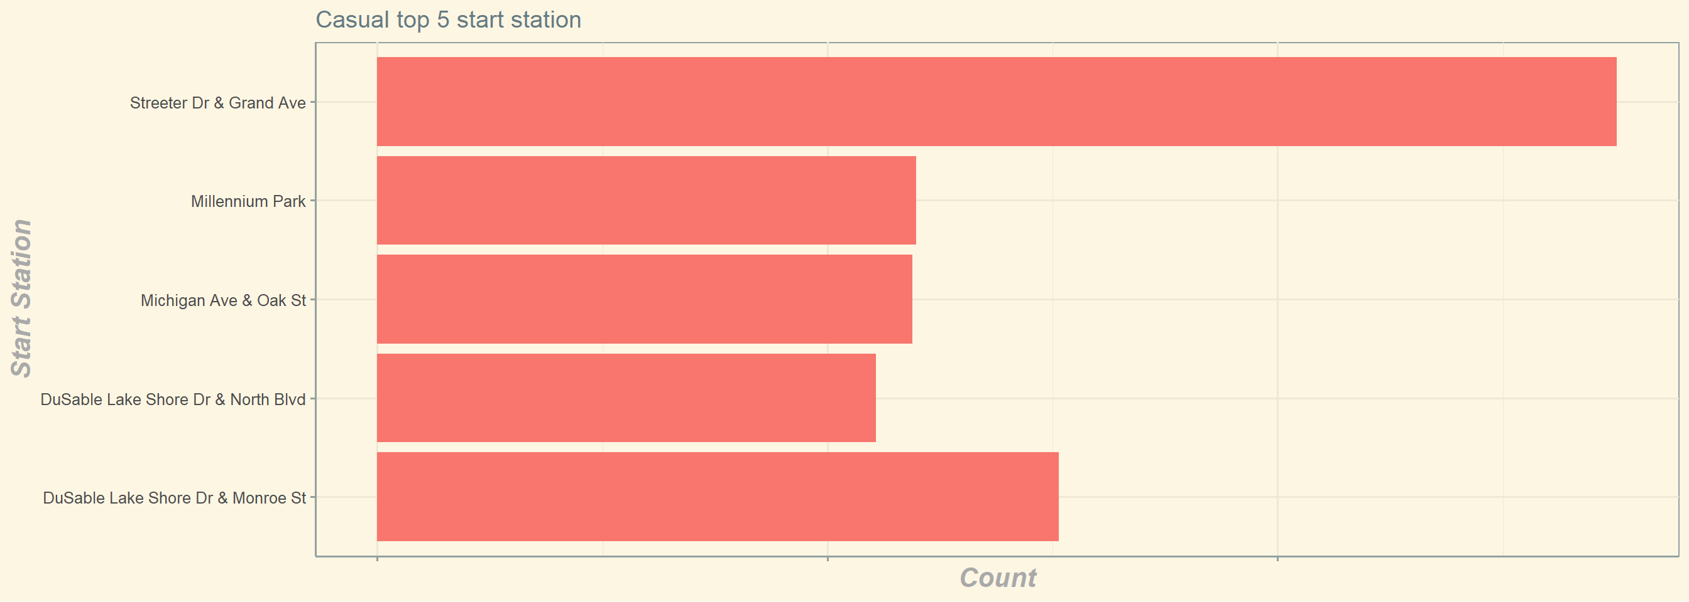
Top 5 Starting Stations

Slide 9
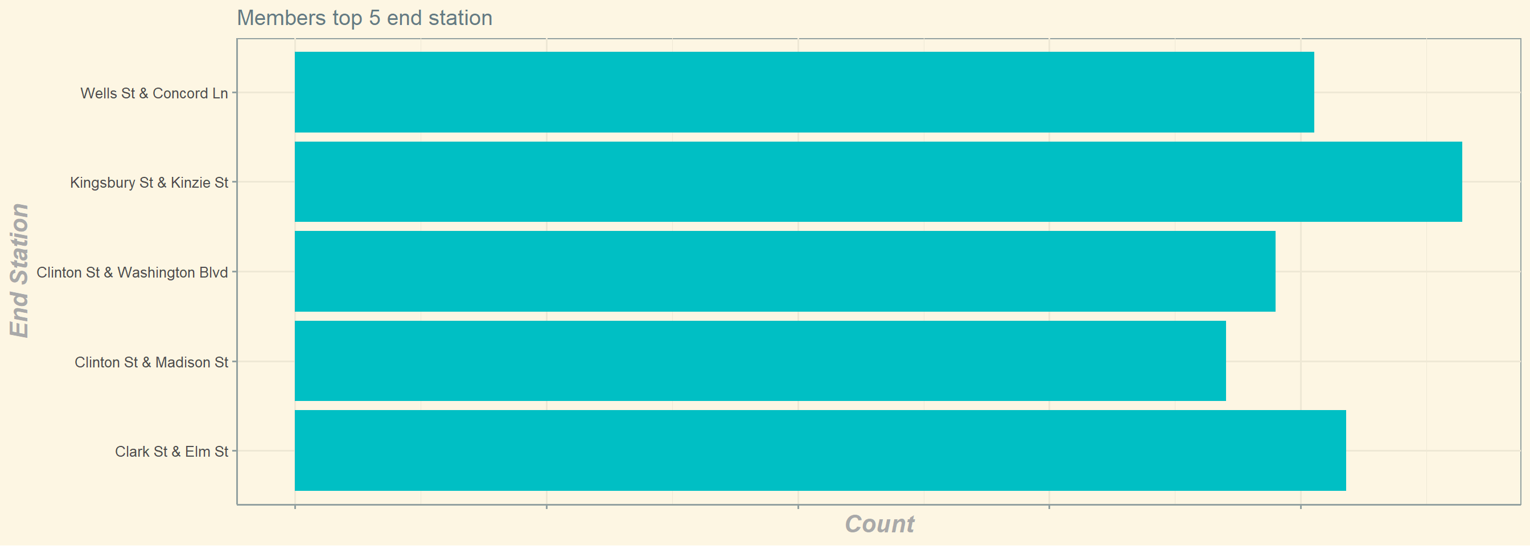
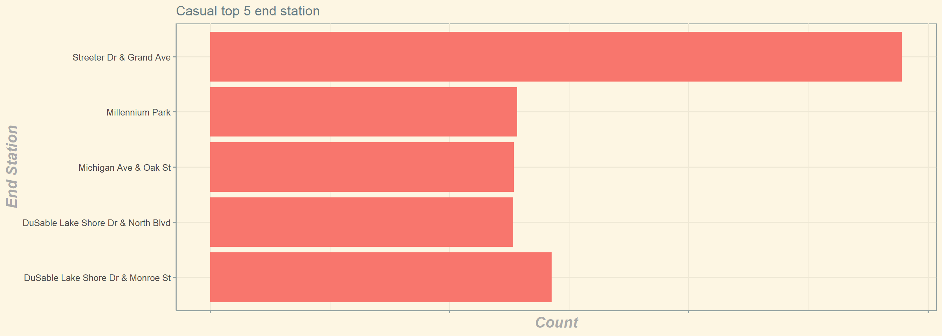
Top 5 Ending Stations

Slide 10
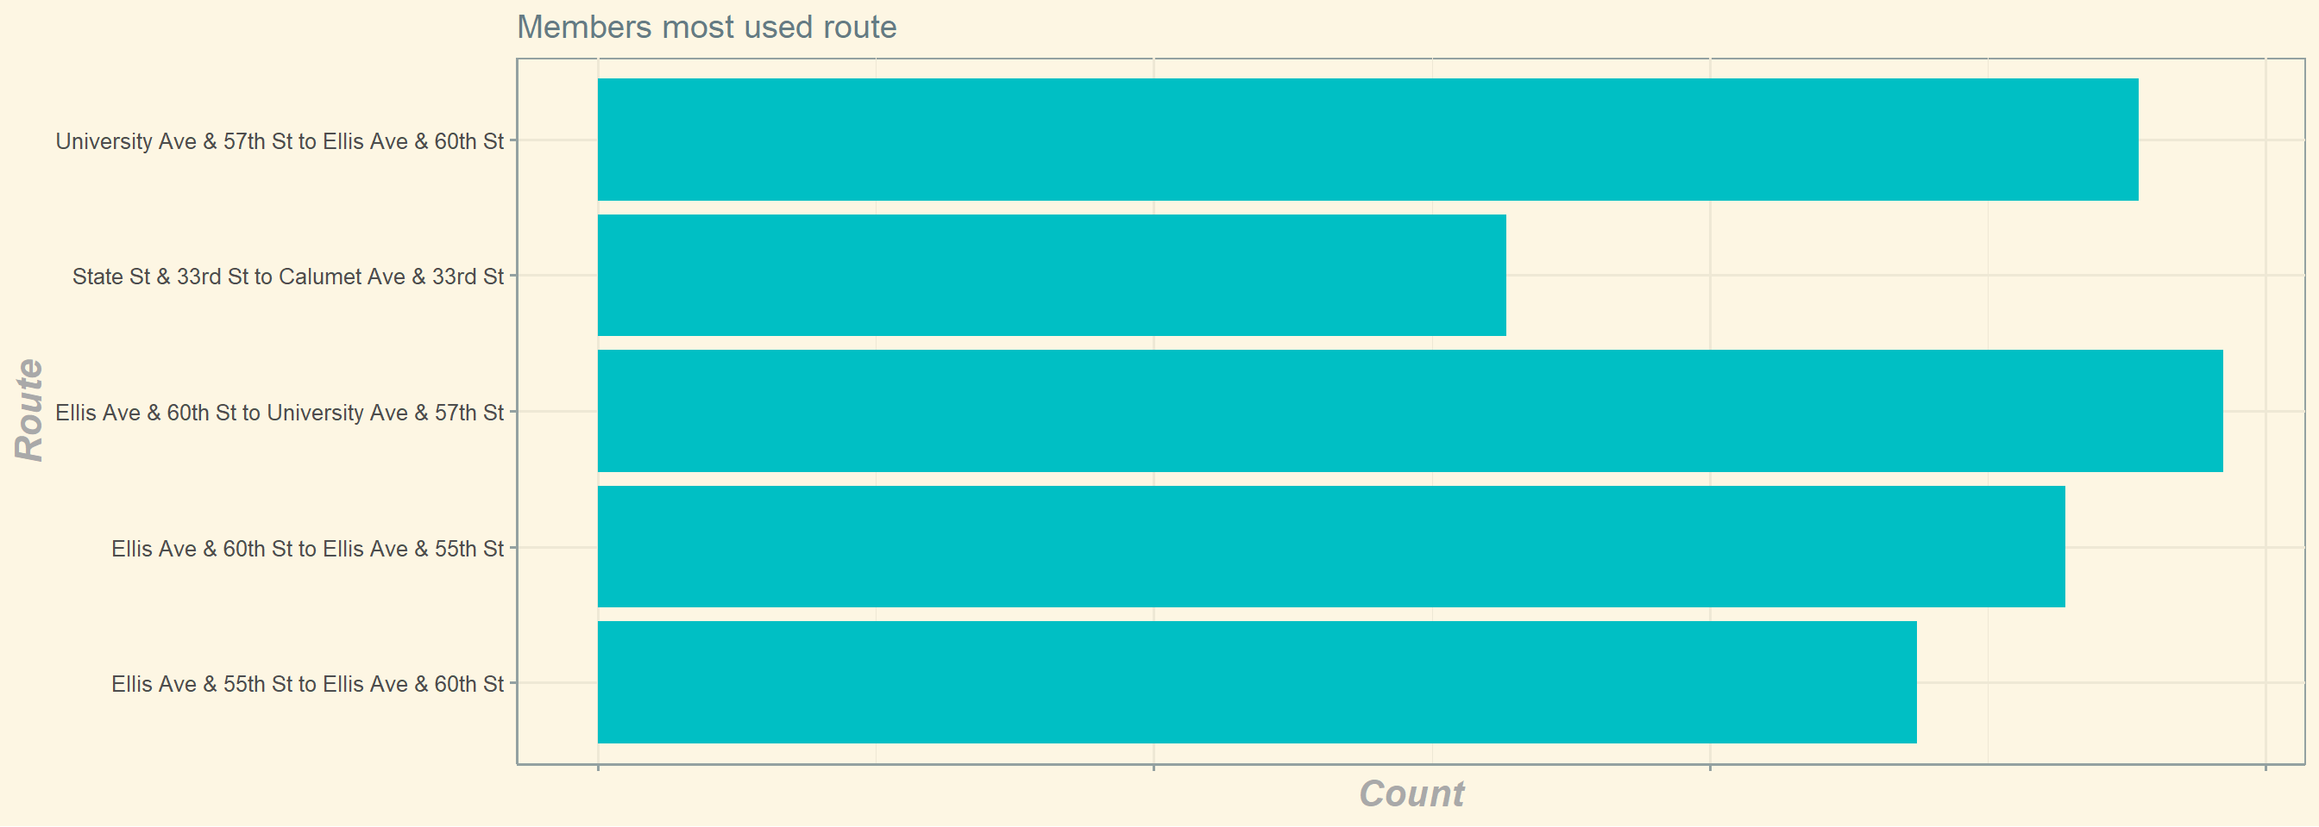
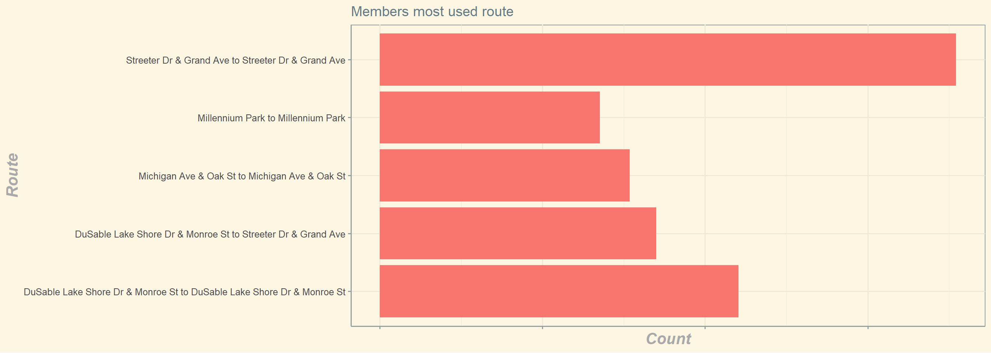
Top 5 Routes

Slide 11
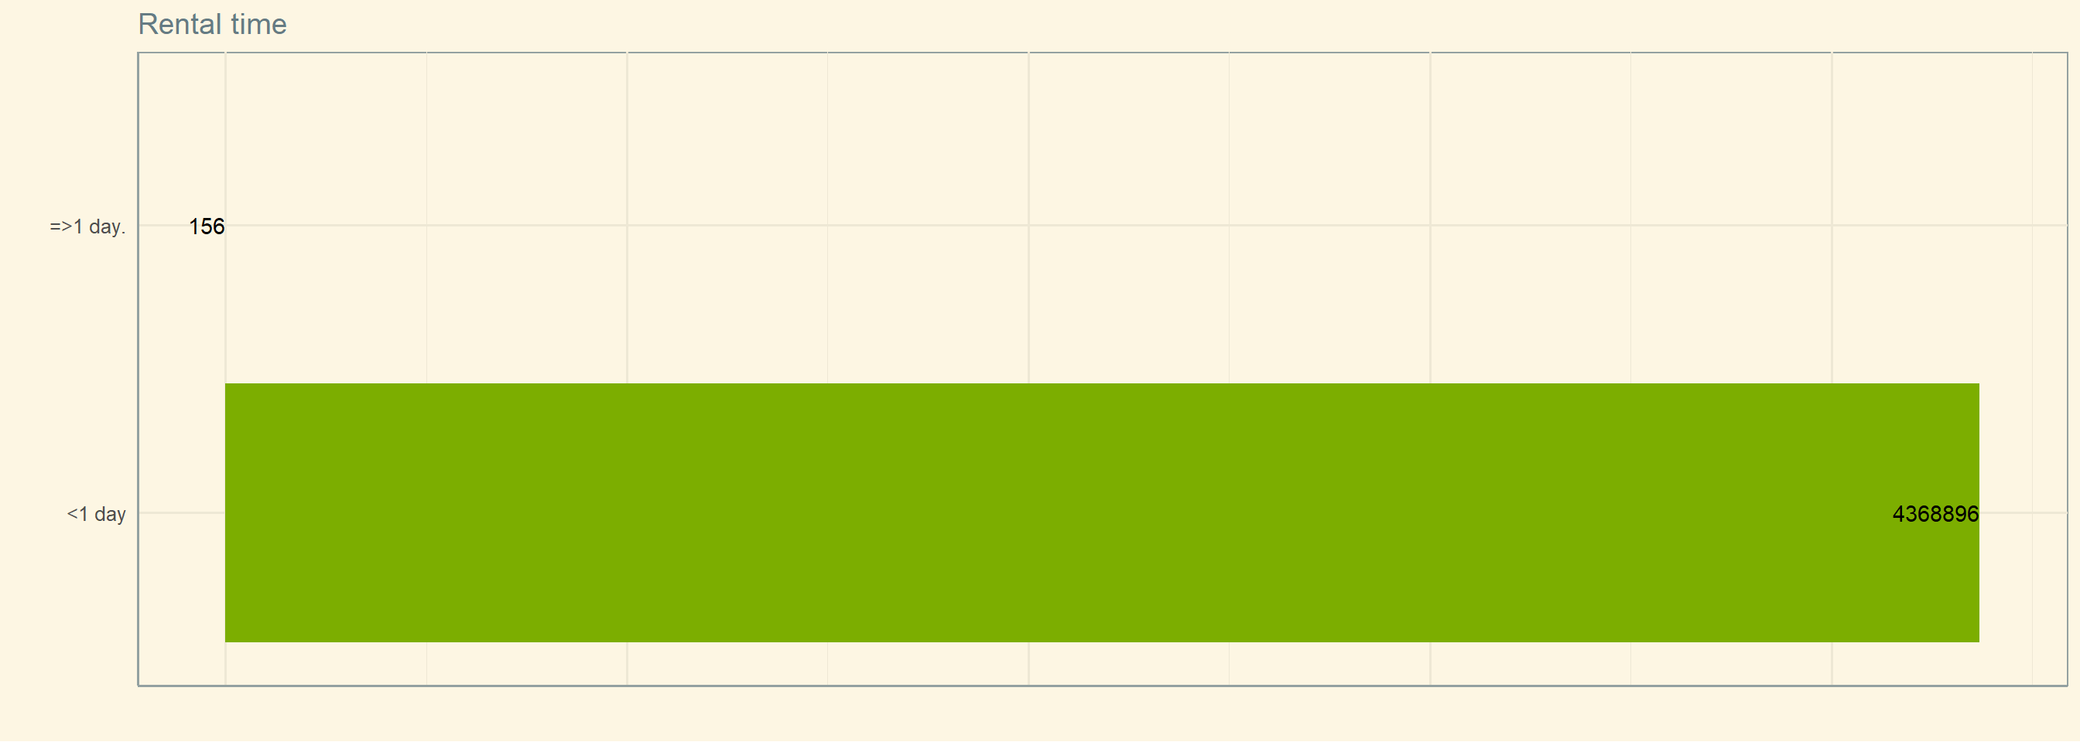
Rental Duration (<1 day vs >= 1 day)

Slide 12
Top 3 Recommendations
Electric bike fever
Casual customers prefer to use electric bikes.
Summer fling
The most popular time of the year for casual riders is summer.
We can enhance our advertisement during June, July, and August
Most used route
Casual riders and members use different starting and ending stations
Focus the advertisement at the casual riders’ most used stations.
We can offer better deals to members on electric bike rental.

Slide 13
Thank you

